Slide 1
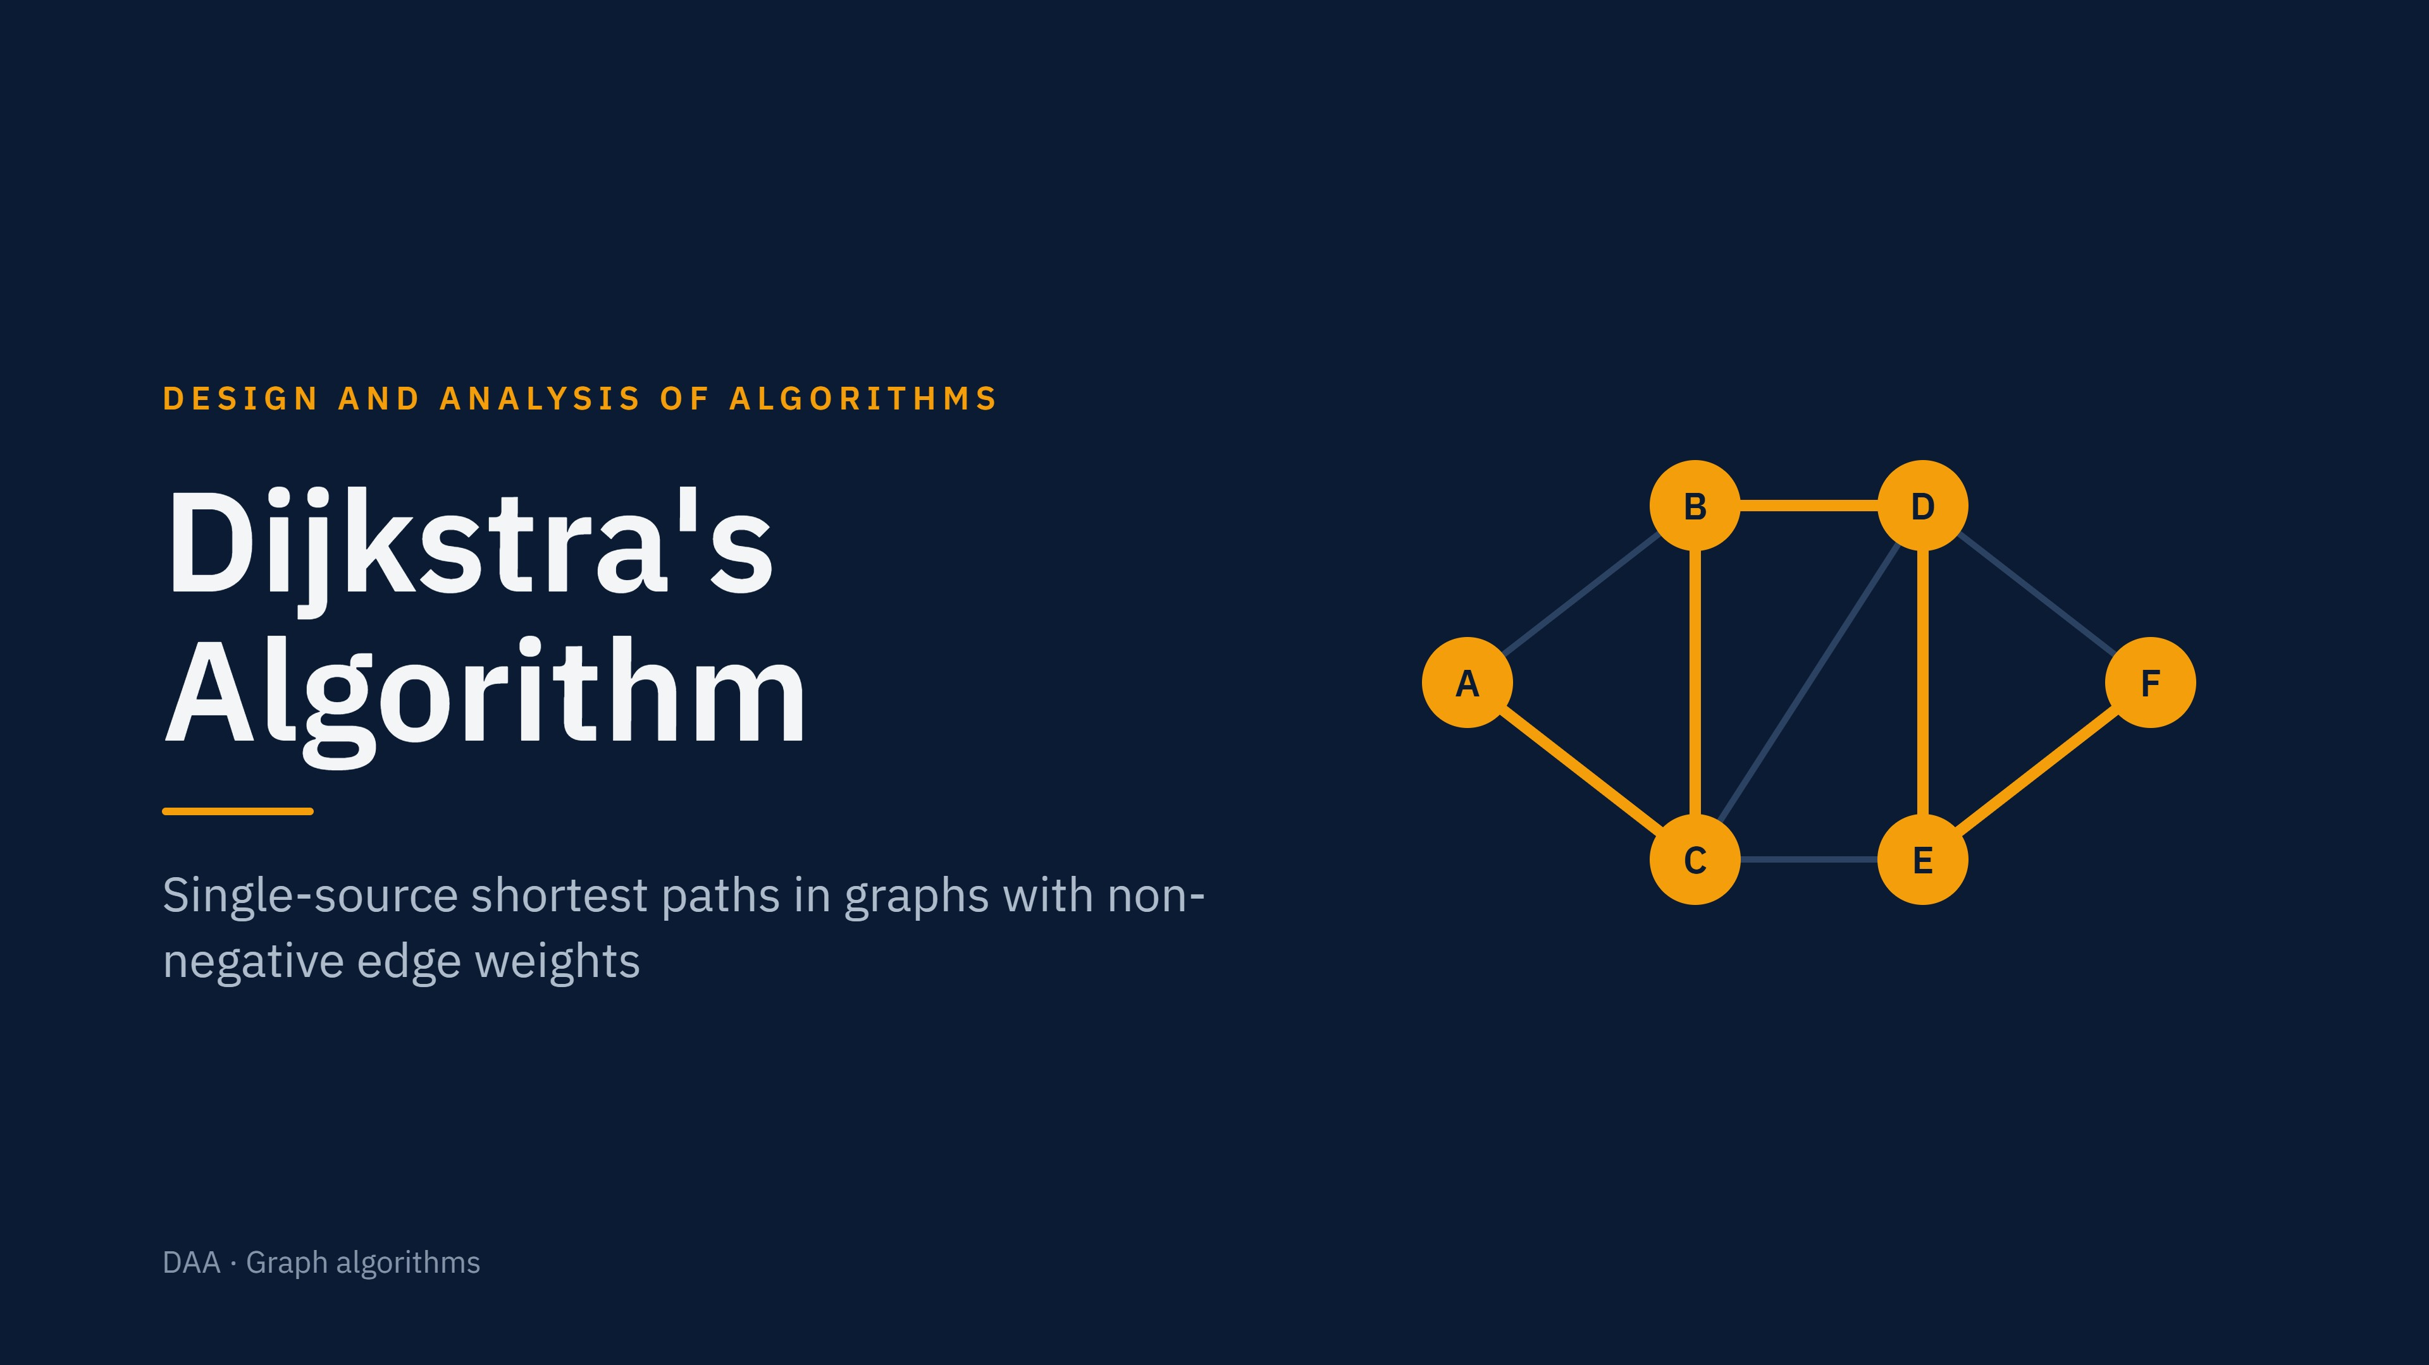
Notes:
Dijkstra's algorithm finds the shortest distance from one source vertex to every other vertex in a weighted graph with non-negative edges. The highlighted graph on the right previews the answer we derive in the worked example: the shortest path from A to F runs A, C, B, D, E, F.

Slide 2
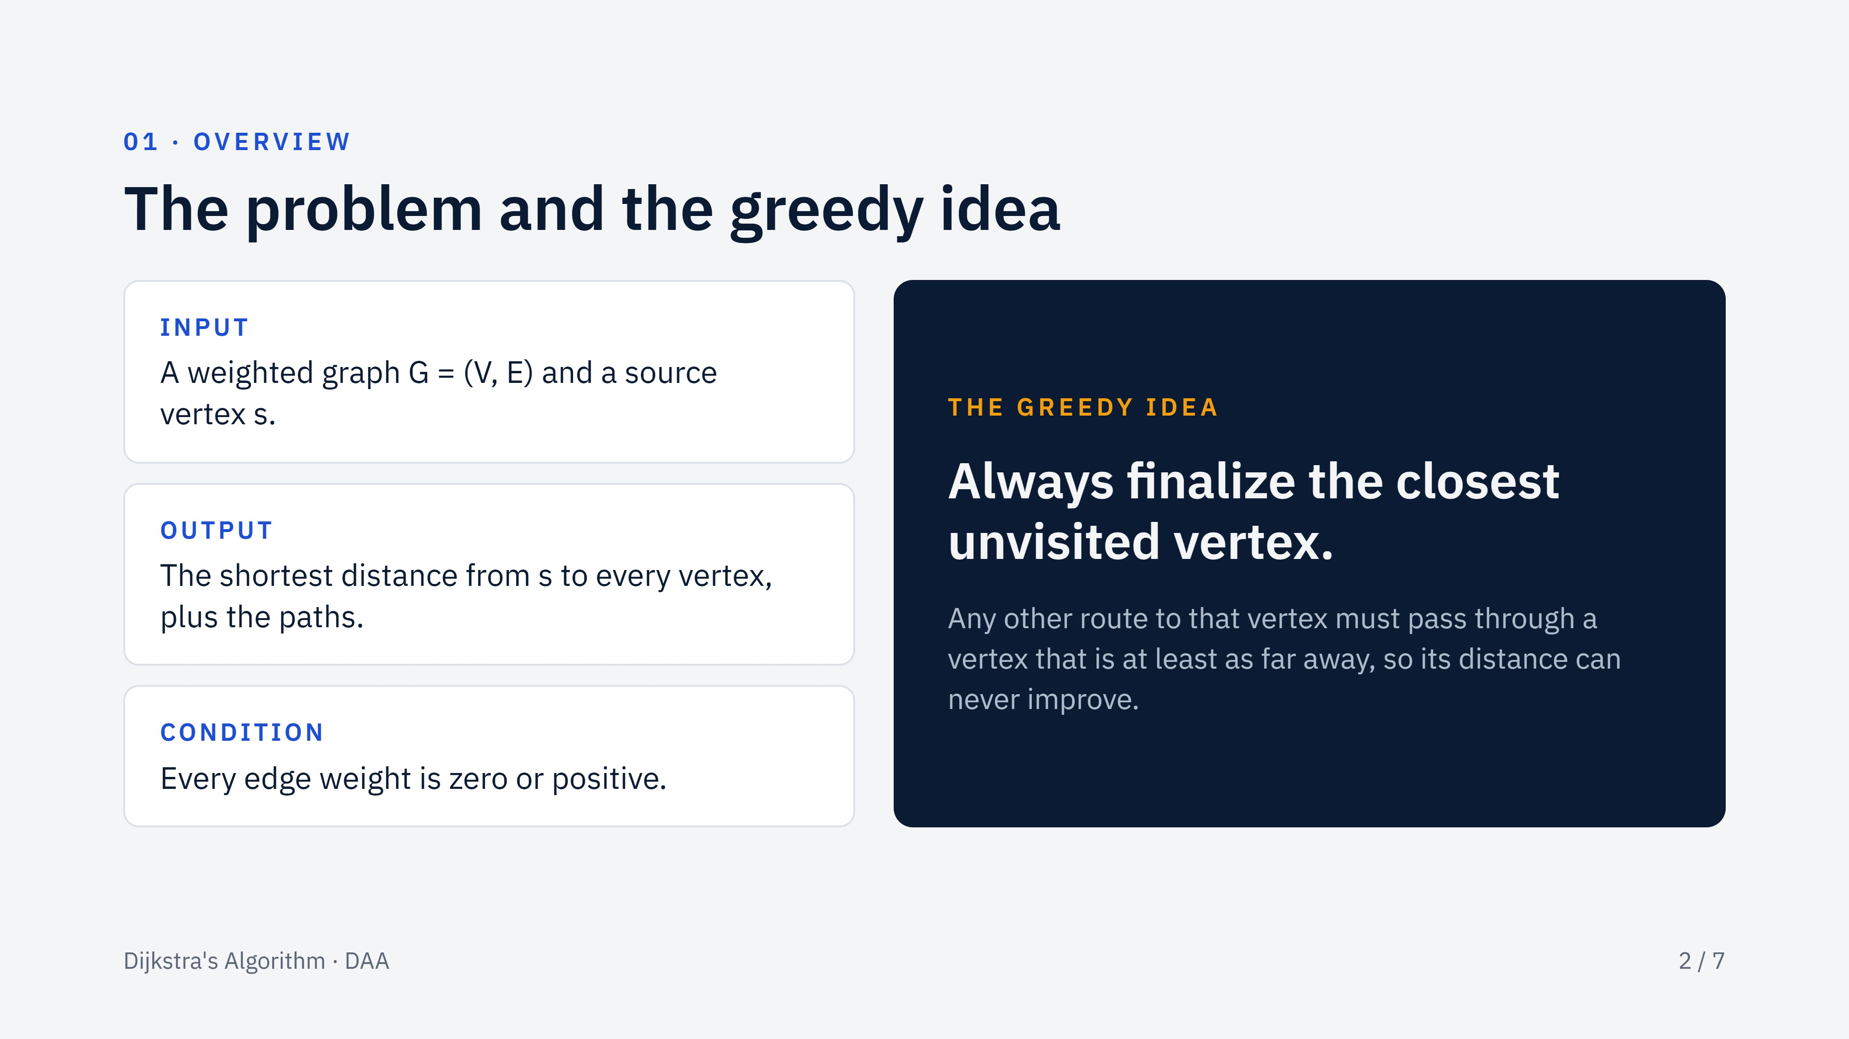
Notes:
Set up the problem: one source, a weighted graph, and no negative edges. The greedy idea on the right is the whole algorithm in a sentence. The non-negative condition is what makes that greedy choice safe, which we revisit on the analysis slide.

Slide 3
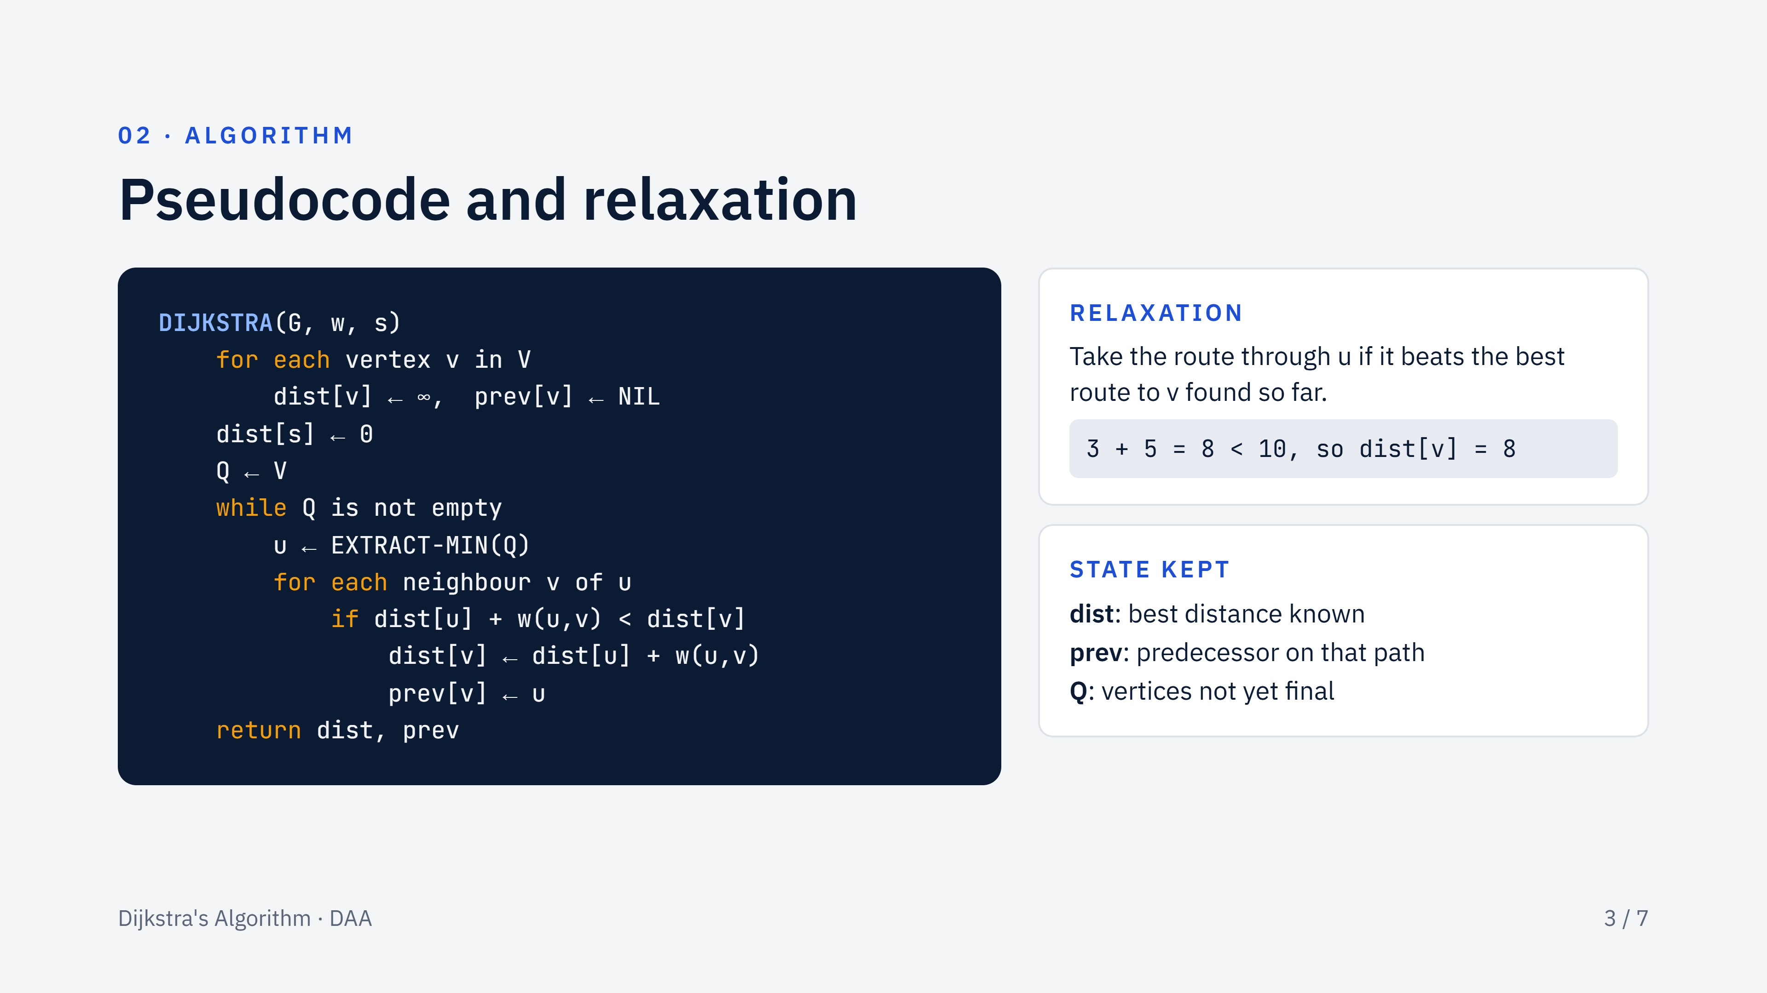
Notes:
Walk through the code top to bottom. Initialization sets every distance to infinity except the source. Each pass of the while loop extracts the unfinished vertex with the smallest distance, then relaxes its outgoing edges. Relaxation is the only operation that changes a distance. The example on the right: u has distance 3 and an edge of weight 5 to v, which currently has distance 10, so v improves to 8.

Slide 4
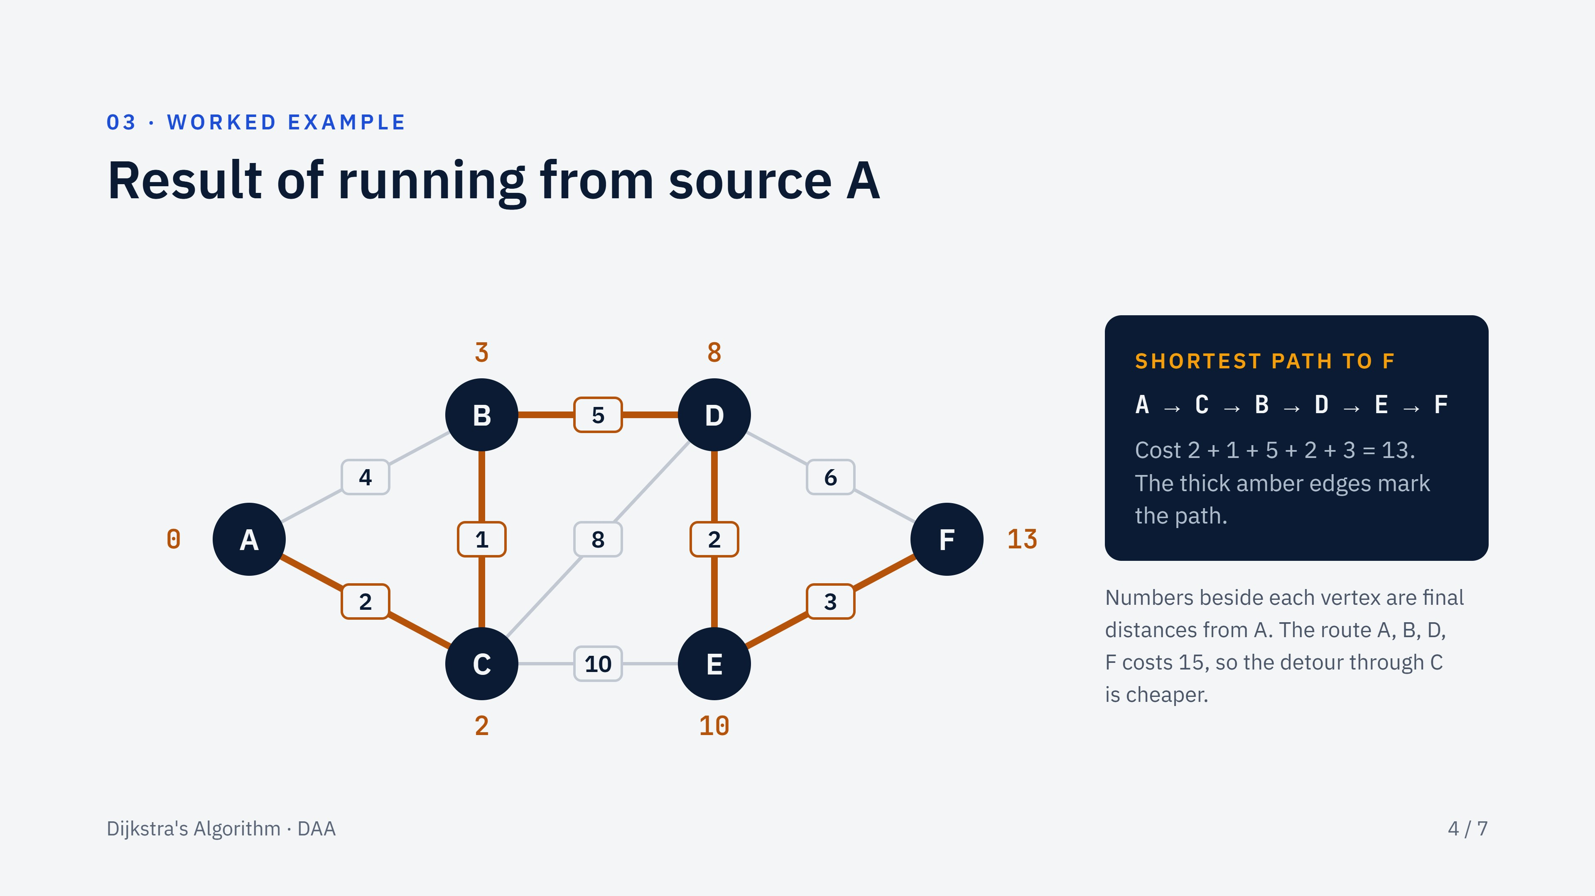
Notes:
This is the graph used for the example: six vertices, nine undirected edges, source A. The final distances are A 0, C 2, B 3, D 8, E 10, F 13. Following the predecessor pointers back from F gives the path A, C, B, D, E, F with total cost 13. The next slide shows how the algorithm gets there, step by step.

Slide 5
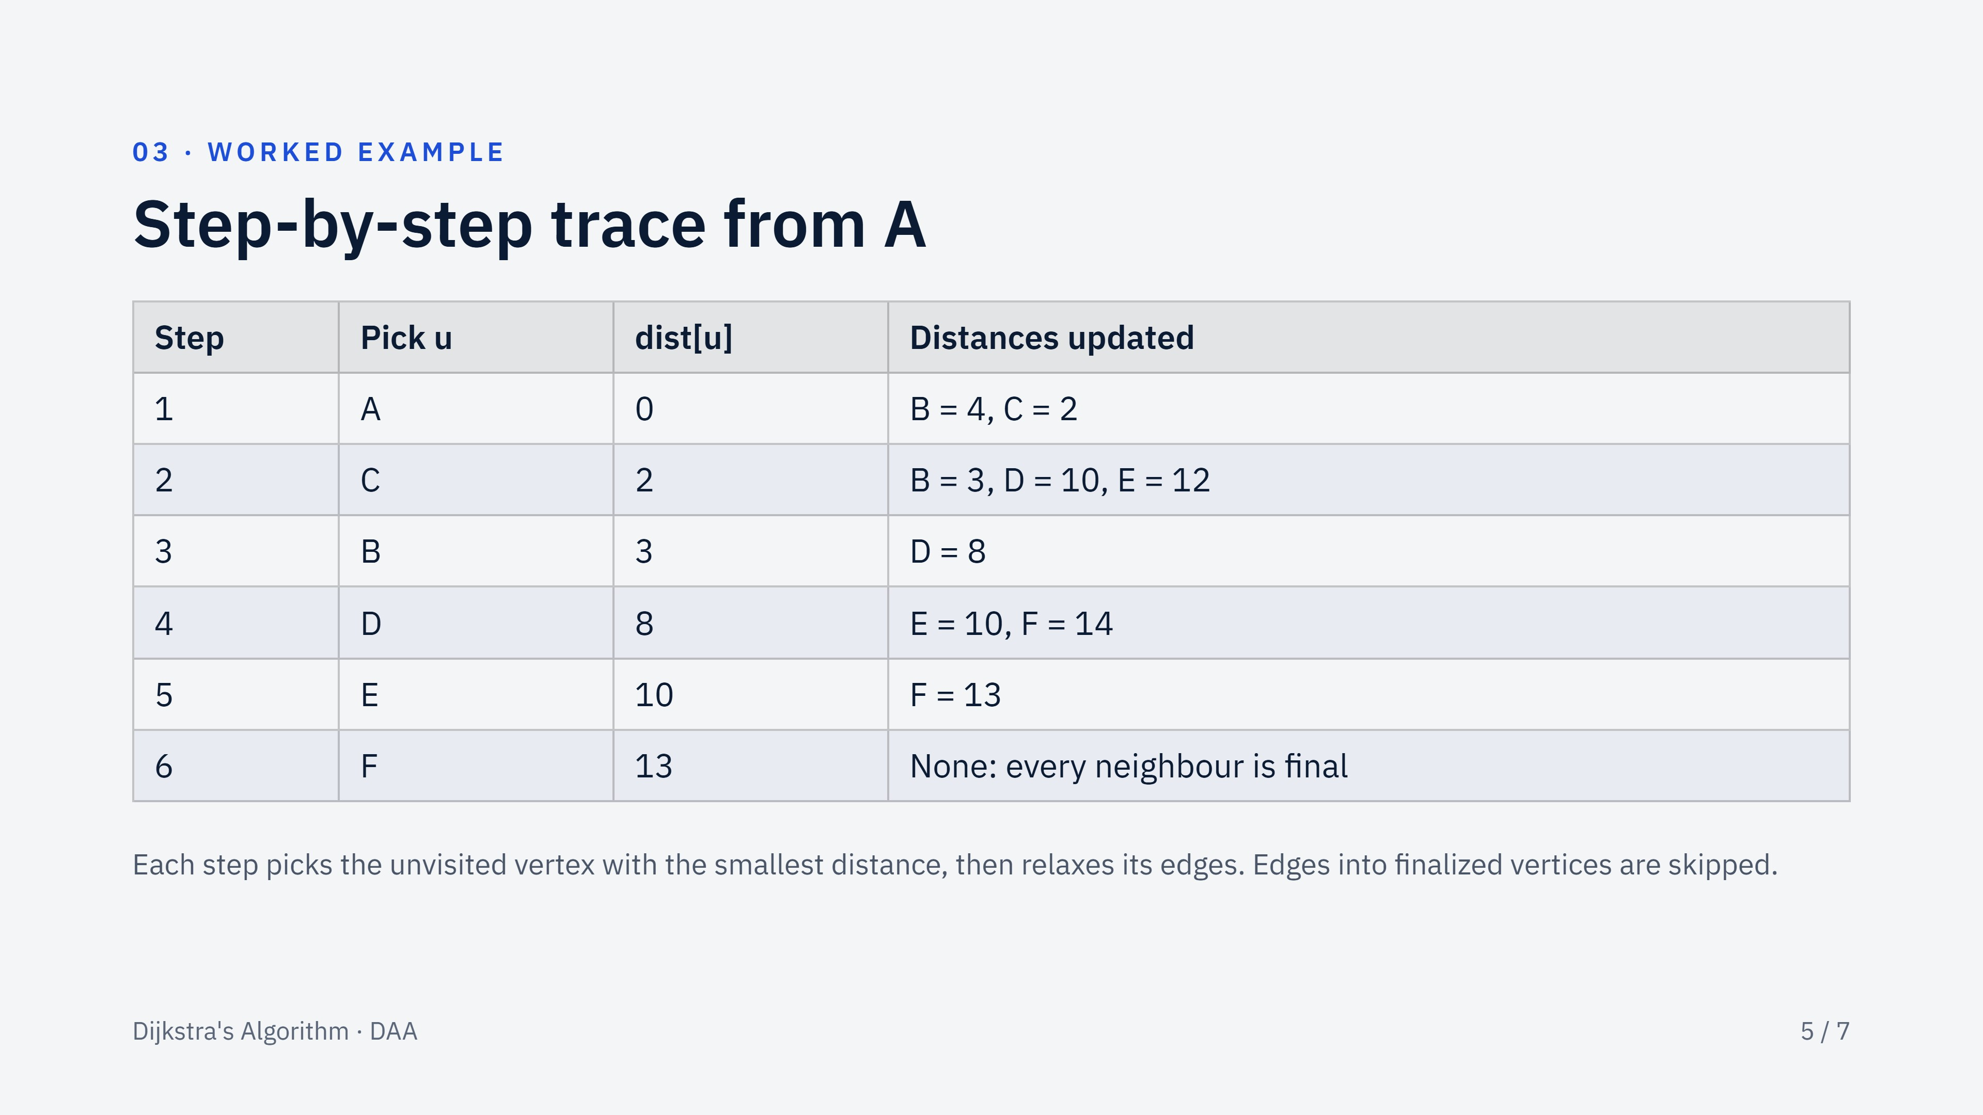
Notes:
Read the table row by row. Step 2 is the interesting one: C is picked because its distance 2 is the smallest, and it improves B from 4 to 3, since the route A, C, B costs 2 plus 1. Step 3 improves D from 10 to 8 through B, and step 4 improves E from 12 to 10 through D. Step 4 also sets F to 14, which step 5 improves to 13 through E. The extraction order is A, C, B, D, E, F.

Slide 6
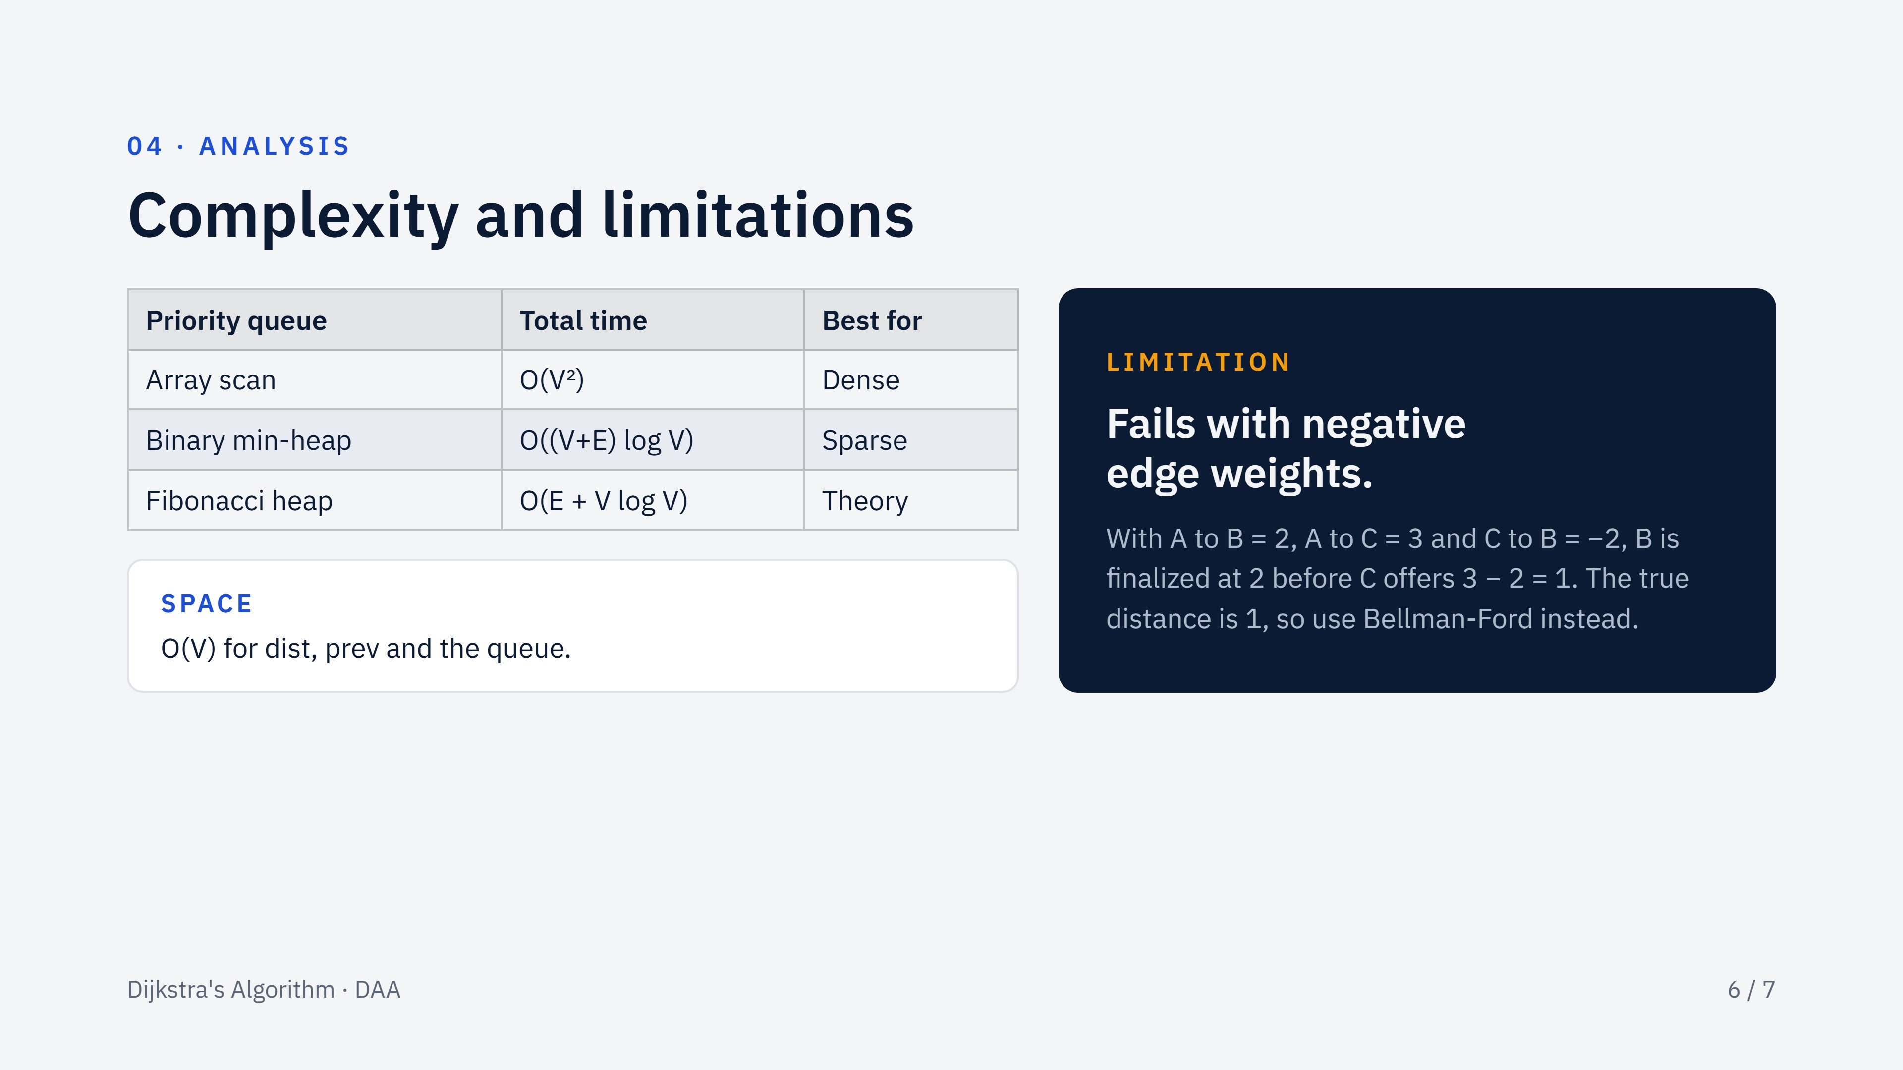
Notes:
The running time depends on the priority queue. With an array, each extract-min scans all vertices: V squared. With a binary heap, V extractions and up to E updates each cost log V. A Fibonacci heap makes decrease-key amortized constant, though binary heaps usually win in practice. The limitation on the right is the counterexample for why edge weights must be non-negative: a finalized vertex is never revisited, so a later negative edge cannot repair it.

Slide 7
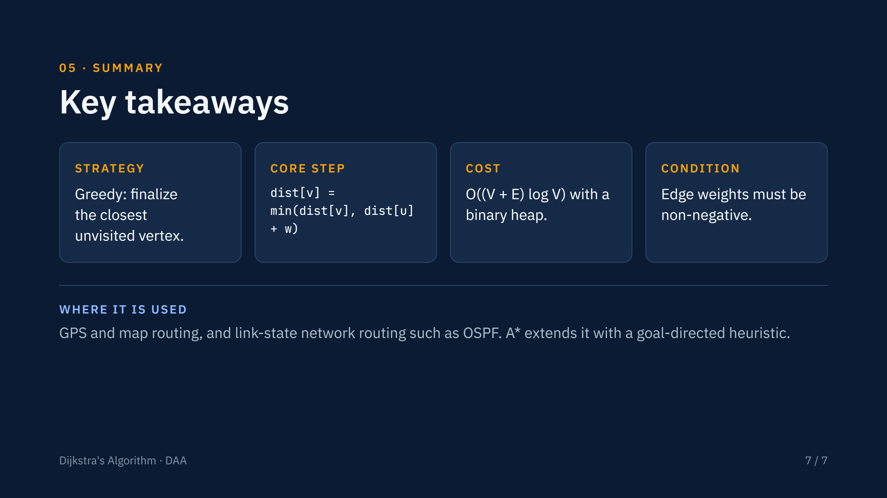
Notes:
Close with the four points to remember: the greedy choice, the relaxation step, the complexity with a heap, and the non-negative weight requirement. Real systems use it for road navigation and for OSPF routing; A* is Dijkstra with a heuristic.

